Slide 1


Drew Young
August 22nd, 2024

Slide 2

Outline
Executive Summary
Introduction
Methodology
Results
Conclusion
Appendix

Slide 3
Executive Summary
Primary Findings:
Successful landings have increased since the first landing in June 4th, 2010.
All four SpaceX sites are based in the US, one on the west coast and 3 on the east coast.
Future landing outcomes can be best predicted using the Tree classification model, however it does have an issue with producing false positives.
The main contributing factors towards a successful landing are
Orbit Types SSO & VLEO
Payloads between 2,000 – 5,500 kg
FT & B4 Boosters
Launch Site KSC LC-39A
Methodologies:
Data collection using REST API and Webscraping.
Optimizing and comparing classification models.
Data Exploration such as:
Plotting
SQL queries
Folium
Interactive Dashboard

Slide 4
Data analysis can help calculate the launch cost of SpaceX by finding drivers of launch success and building a predictive model
SpaceX is one of few companies who launch and operate spacecraft, and are recognized as being the first and only one to return a spacecraft from low-earth orbit.
Being able to return the spacecraft and reuse its first stage allows SpaceX to operate on a much lower price point than its competitors with single-use rockets.
SpaceX advertises Falcon 9 rocket launches on its website with a cost of 62 million dollars.
Competitors providers cost upward of 165 million dollars each However, not all SpaceX launches result in a successful return. For a price cost estimation, a better understanding and prediction is needed of future landing outcomes. This problem can be addressing though data analysis of historic launch data with the aim to:
Identify key relations between success rate and parameters such as launch site, payload, booster version, orbits, etc.
Develop a classification model to predict future landing outcome.

Slide 5

Section 1

Slide 6
We used historical data to create a predictive model to figure out the Falcon 9 launch results
Data on SpaceX Falcon9 launches were collected in two ways:
Through the SpaceX API after which a custom dataframe was built using data on Falcon 9 launches.
Scraping from Wikipedia using BeautifulSoup and to create a dataframe.
Data wrangling was used to help find and replace missing data, as well as format data correctly.
In the Exploratory Data Analysis (EDA):
Six visualizations were used to help understand how launch parameters correlate with success rate.
SQL data analysis was used in addition to gain a better understanding of the data.
An interactive Folium map was used to do an analysis of launch site success rates.
An interactive dashboard helped analyze relations between successful launches, launch sites, payloads, and boosters.
A predictive model was created by optimizing and evaluating four classification models for accuracy and results.

Slide 7
Data Collection
SpaceX API:
Call REST API to obtain launch data.
Process data by filtering rows and columns.
Call REST API again on other data such as launch sites, outcome, payload, etc.
Convert data to dataframe for further analysis.
Webscraping:
Obtain data from website using ‘Request’ command.
Convert result using BeautifulSoup.
Extract data from BeautifulSoup object.
Convert data to dataframe and csv file.

Slide 8
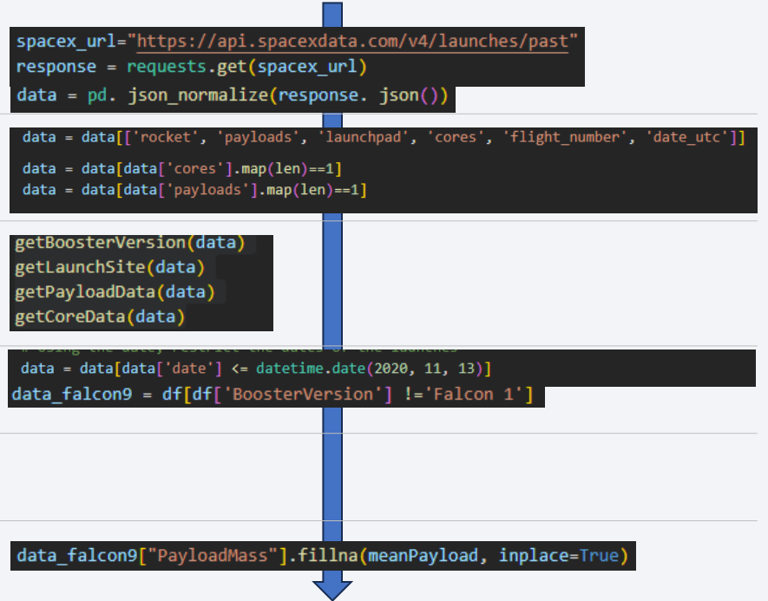
Data Collection – SpaceX API
Get data from SpaceX API and store them in a dataframe.
Limit data to relevant columns.
Enrich the data by obtaining data on boosters, launch sites, payloads, and cores.
Limit the data to launches before November 13th, 2020.
Replace IDs for Boosters.
Replace missing values with mean.

Slide 9
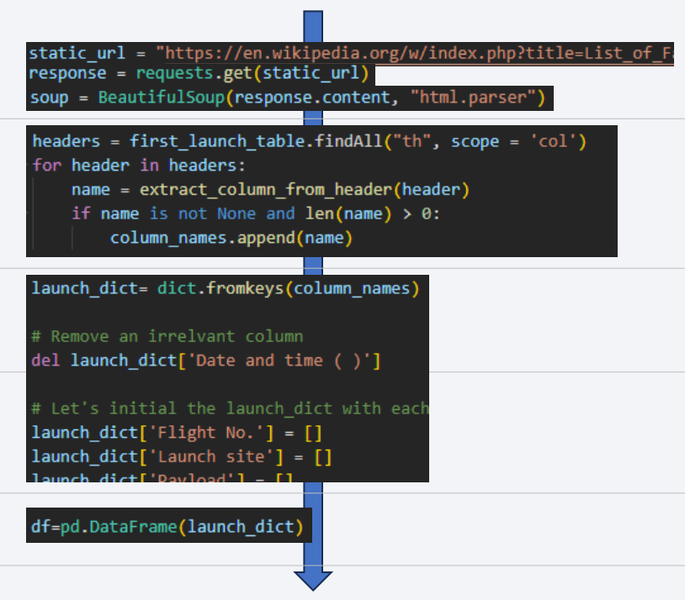
Data Collection - Scraping
Create BeautifulSoup object from Wikipedia page.
Find all column headers from the third page of the table.
Loop through the soup object, finding the ‘th’ elements and appending them to the column names.
Create a dictionary with keys for each relevant column.
Convert dictionary to dataframe.

Slide 10
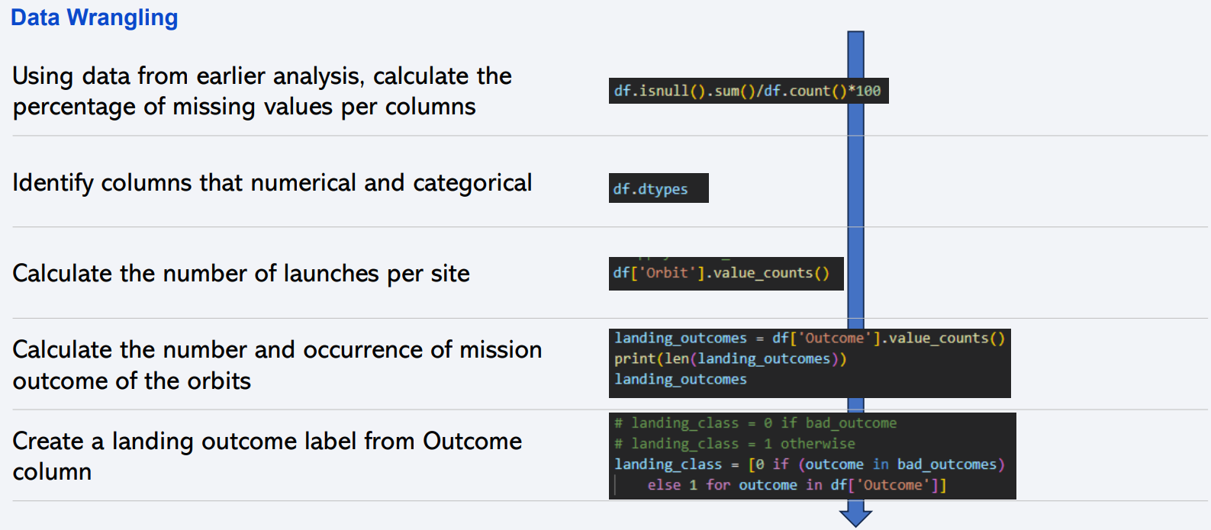
Data is analyzed to get a first impression of their content

Slide 11
EDA with Data Visualization
SpaceX launch data were explored data visualizations of relationships between:
Flight Number and Launch Site
Payload and Launch Site
Success rate of each orbit type
Flight number and Orbit type
Payload and Orbit type
Launch success and year (yearly trend)

Slide 12
EDA with SQL
SpaceX launch data explorations using SQL included amongst others:
List of unique launch sites names
Total payload mass carried by boosters launched by NASA (CRS)
Average payload mass carried by booster version F9 v1.1
Date of first successful landing outcome in ground pad
Names of boosters with successful launches in drone ship and have payload mass between 4000 and 6000
Total number of successful and failure mission outcomes
Names of the booster versions which have carried the maximum payload mass.
List of month names, failure landing outcomes in drone ship, booster versions, launch site for months in 2015
Successful landing outcomes between the 04-06-2010 and 20-03-2017 ranked in descending order

Slide 13
Build an Interactive Map with Folium
Main Findings:
All four SpaceX launch sites are in the US, one in the west coast and three in the east coast.
Launches from KSC LC-39A (west coast) have the best overall success rate.
Site CCAFS LC-40 has been most utilized
All Launch site are located near railroad access for easy of transport and near a coastline and away from cities and highways for safety.
Approach/Methods:
Launch site were plotted on a Folium world by plotting a marker and label using their LoLa-ccordinates.
Information on total launches was added using a MarkerCluster. On zooming in, this also showed all successful launches in green makers and failures in red.
After retrieving the LoLa coordinates of proximities such as railroad, coastline, highway and cities, the distance was calculated using the haversine formula. Then a line between the site and proximity was drawn with a label showing the distance.

Slide 14
Build a Dashboard with Plotly Dash
Main Findings:
Site KSC LC-39A contributes highly to overall launch success.
It has had the most successful SpaceX launches in number.
It has a 77% success rate.
Highest Success Rates are achieved with payloads between the 2 – 5.5 kg range, and FT or B4 boosters.
Approach/Methods:
Interactive Dashboard created with Flask and Dash that:
Showed number of successful launches per site as a pie chart.
Allowed a deep dive per site, by selecting this site in a pulldown menu. The pie chart then showed success vs. failure of the particular site.
Showed an interactive scatter plot with individual launches by success/failure and their payload. Using color, various booster types were distinguished.
Allowed for deep dive analysis by setting the payload range using a slider and by toggling booster versions.

Slide 15
Predictive Analysis (Classification)
Main Findings:
Linear Regression (LR), SVM, Tree, and and KNN classification models were used.
The Tree classification model is able to obtain highest accuracy.
Accuracy of other models (Linear Regression, Support Vector Machine, K nearest neighbors) were comparable.
The Tree models still has an issue with producing false positives. This is similar to other models.
Approach/Method:
Import launch data and normalize values.
Split data into training and test data.
Perform GridSearch, calculate accuracy, and analyze confusion matrix for each data group.
Compare results for all four models.

Slide 16
Results
Exploratory data analysis results
Interactive analytics demo in screenshots
Predictive analysis results

Slide 17

Section 2

Slide 18
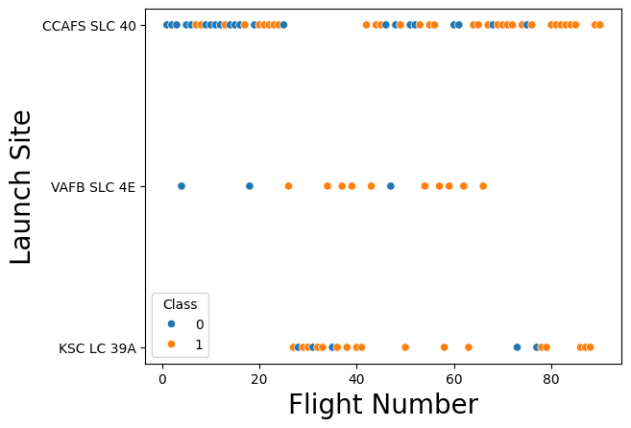
Flight Number vs. Launch Site
Success Rate increases as flights are built up; this also seems to be the case per launch site.
Variations in success rates per launch site are less obvious.
The high success rate of KSC LS 39A is potentially caused by its later start (with higher flight numbers) compared to other sites.

Slide 19
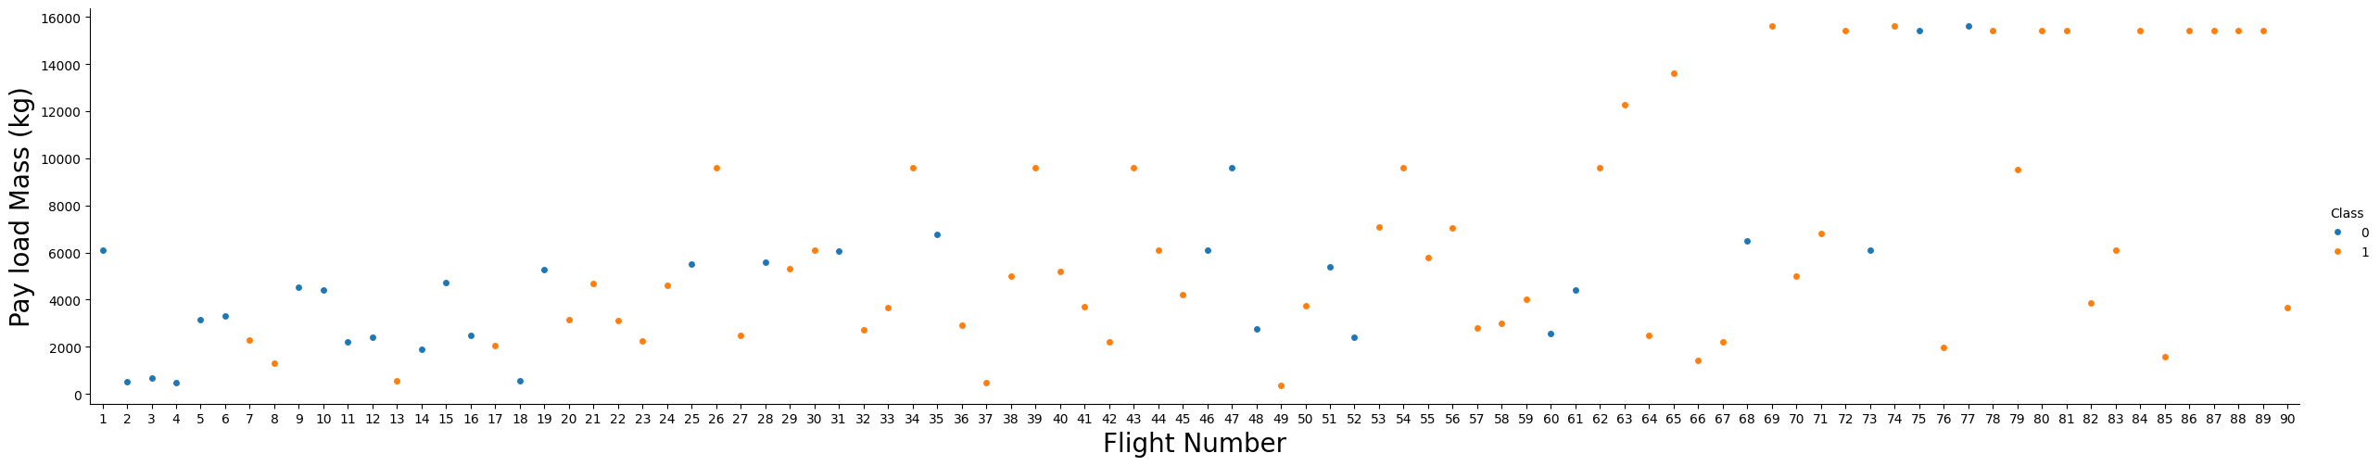
Payload vs. Launch Site
For the CCAPS SLC-40 site, launch success rate seems to increase with payload
For other sites this is less clear
It could very well be that payload has been increased as experience increased (see previous slide)

Slide 20
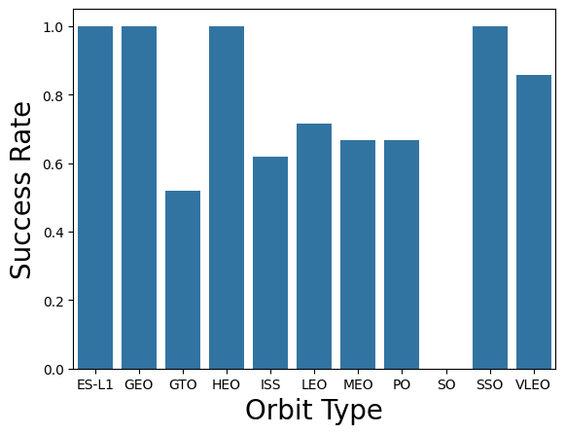
Success Rate vs. Orbit Type
SSO and VLEO have over 80% success rate based on multiple launches
ES-L1, GEO, and HEO only have a single launch to them, so their results aren’t conclusive.

Slide 21
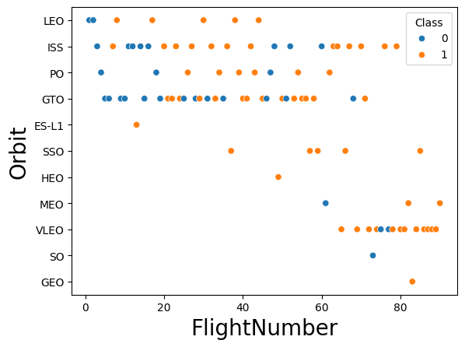
Flight Number vs. Orbit Type
Earlier Orbit Types such as LEO, ISS, and GTO have a lower success rate compared to newer orbit types like VLEO.
It’s also shown that as more flights are taken with each orbit type, the success rate increases

Slide 22
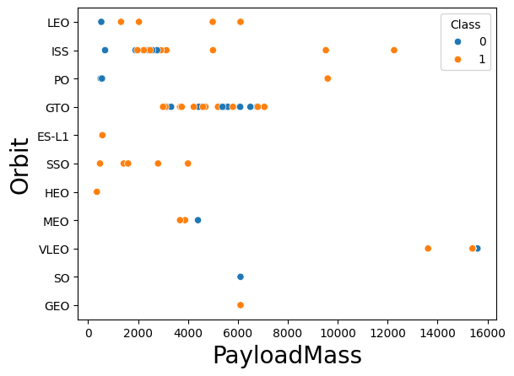
Payload vs. Orbit Type
It’s unclear if Payload mass correlates with launch success rates.
Some orbit types have improved success rates with increased payloads, like LEO & ISS
Some orbit types have decreased success rates with increased payloads, like GTO
Most payloads range from 2000kg – 7000kg.

Slide 23
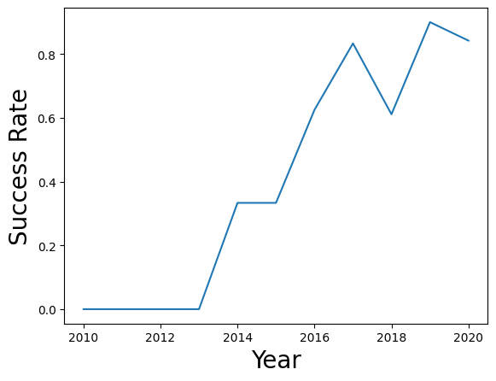
Launch Success Yearly Trend
Launch success rates have greatly increased over the years.
The number of launches have also increased over the years, which correlates with the earlier observation that launch success rates increase when more launches are taken.

Slide 24
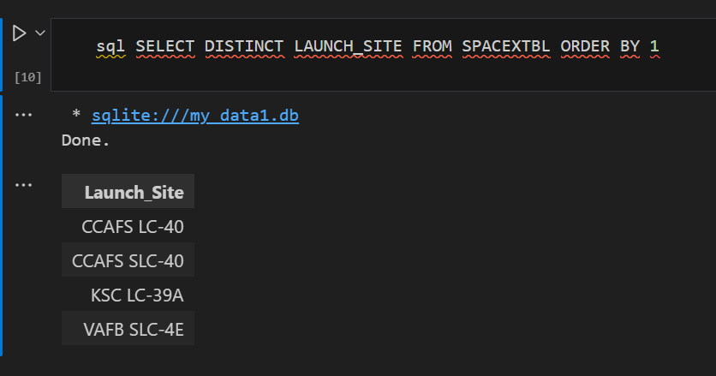
All Launch Site Names
Launch Site Names:
CCAFS LC-40
CCAFS SLC-40
KSC LC-39A
VAFB SLC-4E

Slide 25
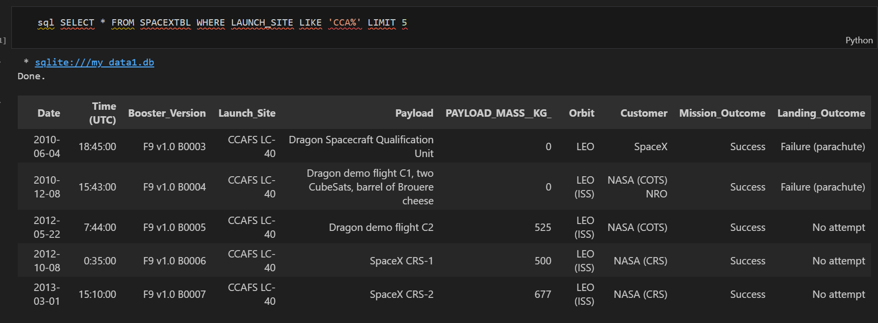
Details of first 5 flights from a launch sites starting with ‘CCA’
Find 5 records where launch sites begin with `CCA`
Present your query result with a short explanation here

Slide 26
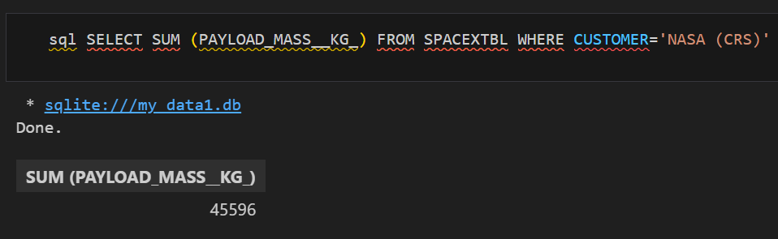
Total Payload Mass
Total payload mass of NASA boosters is 45,596 kg.

Slide 27
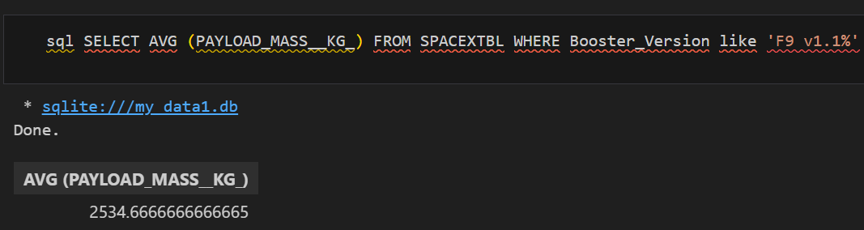
Average Payload Mass by F9 v1.1
Booster version F9 v1.1 (variants) carried 2,535 kg payload on average.

Slide 28
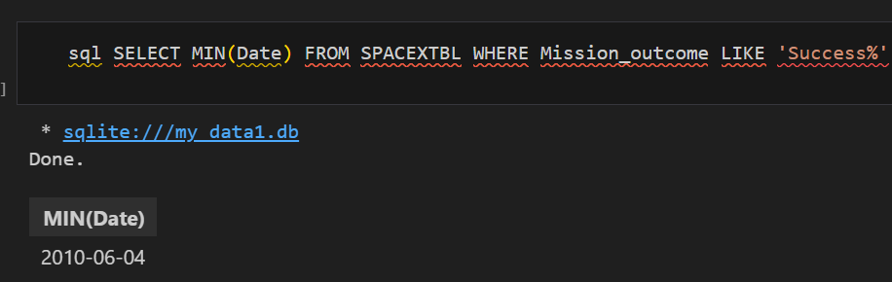
First Successful Ground Landing Date
The first successful ground landing took place on June 4th, 2010.

Slide 29
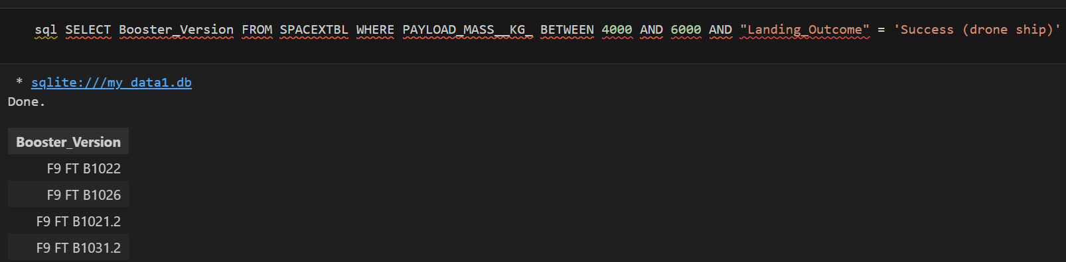
Successful Drone Ship Landing with Payload between 4000 and 6000
Four boosters had success with drone ship landings with payloads between 4000 – 6000kg.

Slide 30
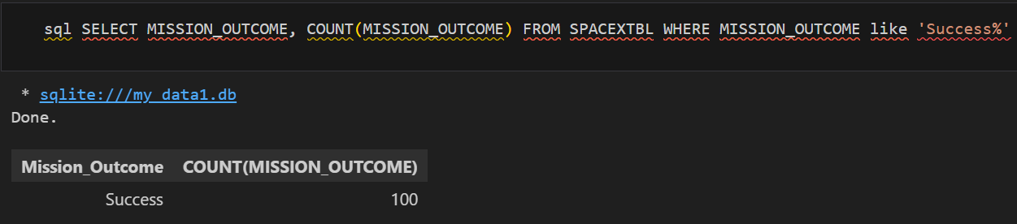
Total Number of Successful and Failure Mission Outcomes
There were 100 successful launches out of the total missions.

Slide 31
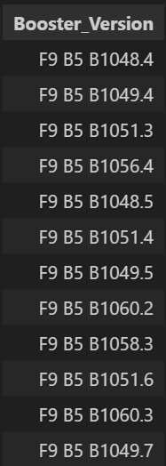
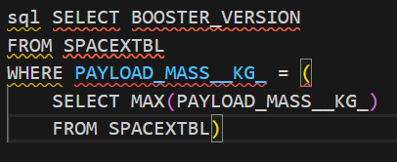
Boosters Carried Maximum Payload
There were a total of 12 boosters that carries the max payload of 15,600kg.

Slide 32
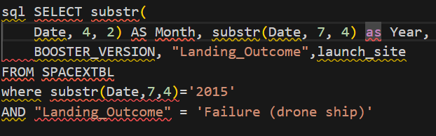
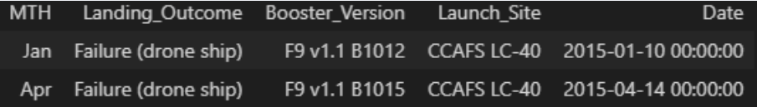
2015 Launch Records
There were two failed drone ship landings in April and January, respectively.

Slide 33
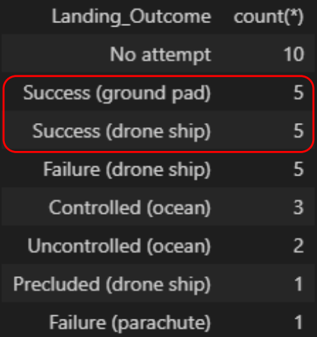
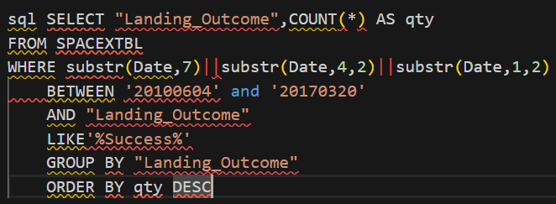
Rank Landing Outcomes Between 2010-06-04 and 2017-03-20
Between 2010-06-04 and 2017-03-20, 10 of 32 launches had a successful landing outcome.

Slide 34

Section 3

Slide 35
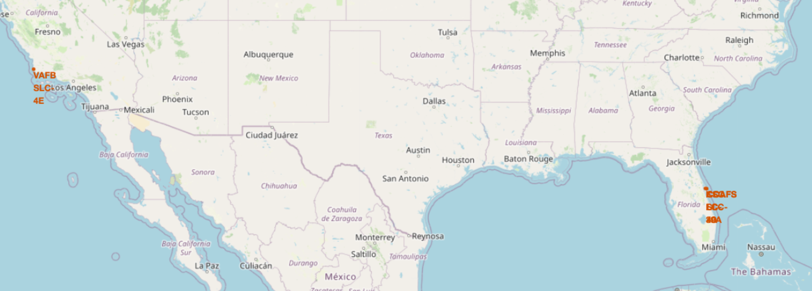
All four SpaceX launch sites are in the US, one on the west coast and three on the east coast.
Replace <Folium map screenshot 1> title with an appropriate title
Explore the generated folium map and make a proper screenshot to include all launch sites’ location markers on a global map
Explain the important elements and findings on the screenshot

Slide 36
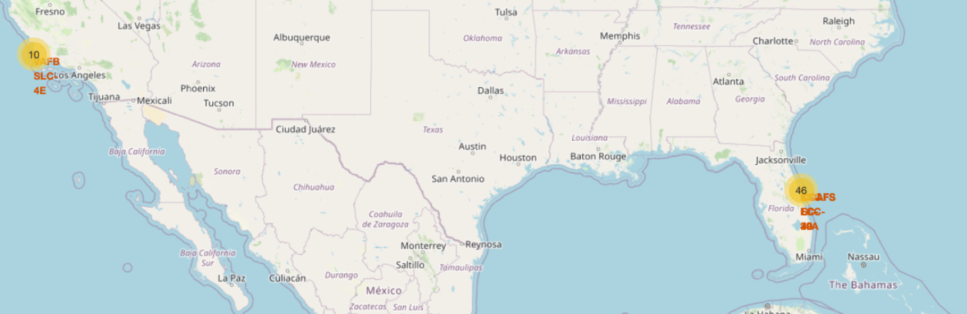
Launches from KSC LC-39A have the best overall success rate; CCAFS LC-40 has been most utilized.
Replace <Folium map screenshot 2> title with an appropriate title
Explore the folium map and make a proper screenshot to show the color-labeled launch outcomes on the map
Explain the important elements and findings on the screenshot

Slide 37

Section 4

Slide 38
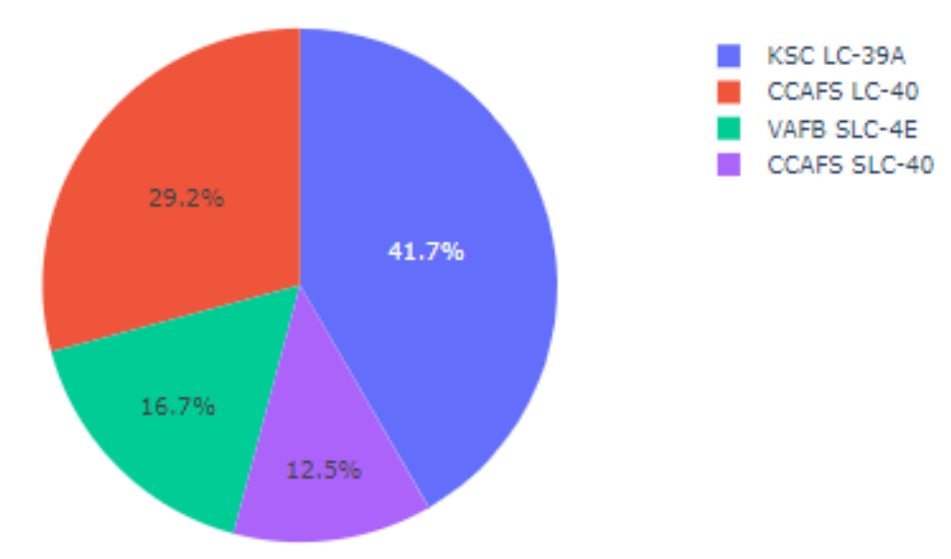
Site KSC LC-39A had the most successful launches

Slide 39
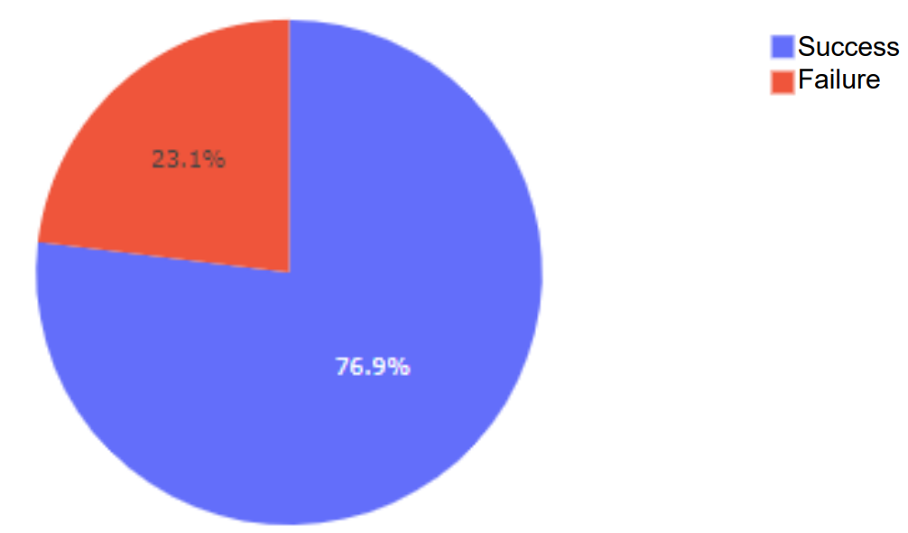
KSC LC-39A had a 77% success rate

Slide 40
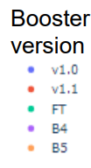
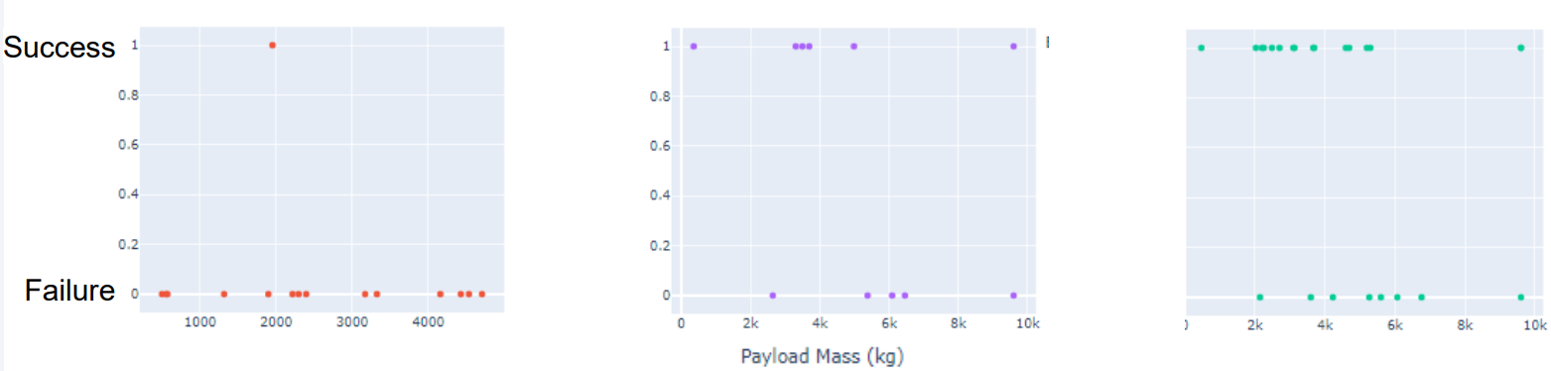
Launch Outcomes for different payloads and Booster Versions
The highest success rates were between 2,000 – 5,500 kg for the FT and B4 Boosters.

Slide 41

Section 5

Slide 42
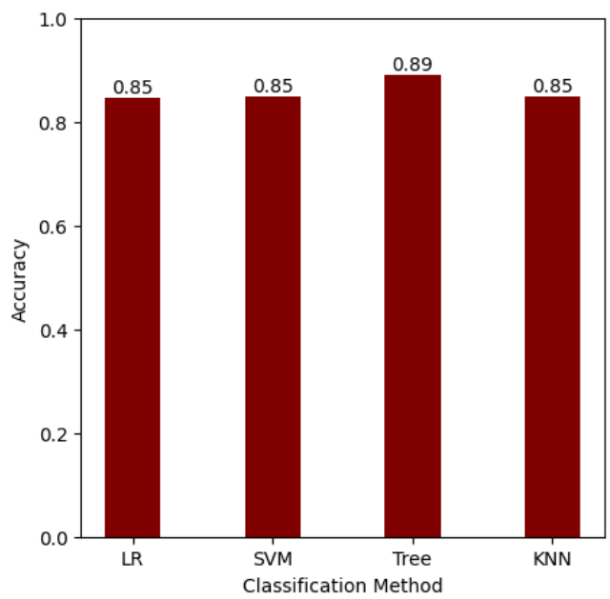
Classification Accuracy
LR, SVM, Tree, and KNN models were used.
The Tree model had the highest accuracy of 89%, with the other models performing at 85%.
Parameters for each model were optimized using GridSearch.

Slide 43
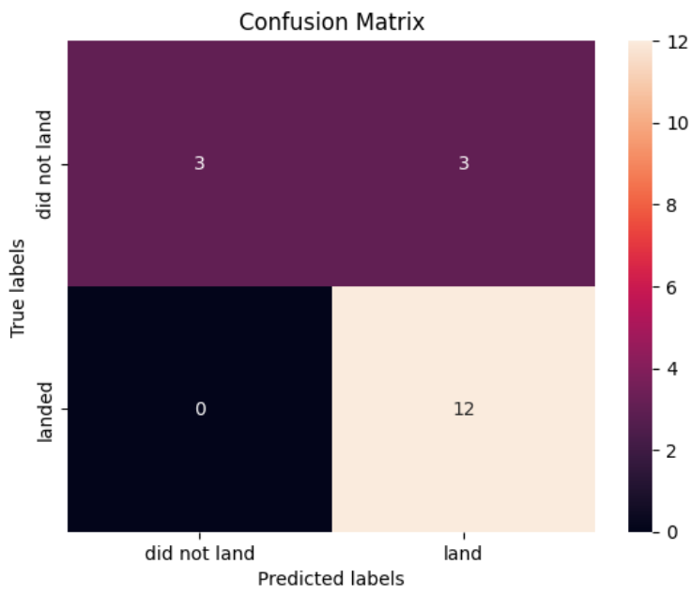
Confusion Matrix
While Tree was the best performing model, it has an issue with producing false positives.
50% of the failed launches were classified as successful launches.

Slide 44
Conclusions
After the first landing on June 4th, 2010, the yearly success rates for launches has increased greatly.
Of the successful landings, a good portion are contributed to the orbit types of SSO and VLEO, which both have over 80% success rates, a payload between 2,000 – 5,500 kg, FT & B4 boosters, and the launch site KSC LC-39A.
All four of the SpaceX launch sites are based in the USA, one located on the west coast in California, and the other three located on the east coast in Florida.
Future landings should be predicted using the Tree classification model, but a problem with false positives can occur.

Slide 45
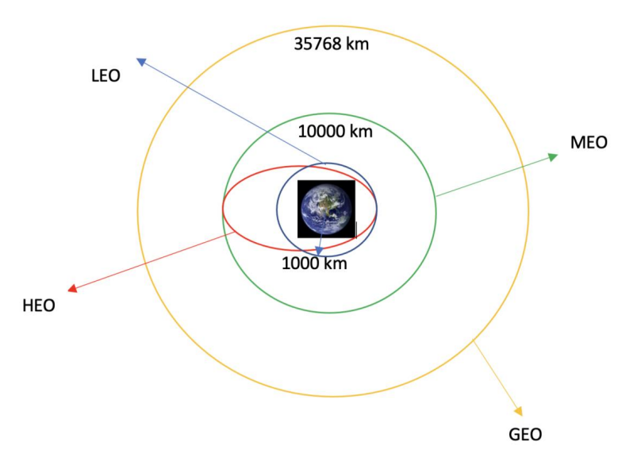
Appendix
Listed below are the following orbit types:
LEO: Low Earth orbit (LEO) is an Earth-centred orbit with an altitude of 2,000 km or less. Most of the manmade objects in outer space are in LEO.
HEO A highly elliptical orbit, is an elliptic orbit with high eccentricity, usually referring to one around Earth.
GEO It is a circular geosynchronous orbit 35,786 km (22,236 miles) above Earth's equator and following the direction of Earth's rotation.
MEO Geocentric orbits ranging in altitude from 2,000 km to just below geosynchronous orbit at 35,786 kilometers (22,236 mi). Also known as an intermediate circular orbit.

Slide 46


